Slide 2
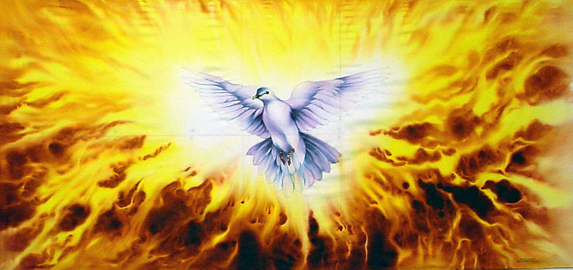
“Thy Kingdom come” this year will start on Ascension Day Thursday 18th May and last until
Pentecost on Sunday 28th May, the time period between Jesus returning to his Father and the disciples
Being given the Holy Spirit
This Photo by Unknown Author is licensed under CC BY-NC-ND

Slide 3
In the days between Ascension and Pentecost, it has been the habit of many Christians, for many centuries, to make the focus of their prayers the same as those first believers. Christ’s last instruction to His disciples on the day of His Ascension is to ‘wait for the gift my Father promised’ (Acts 1:4)
Beginning on Ascension Day until Pentecost Sunday, Christians around the globe, from all denominations, are invited to hold as a focus for their prayers a desire for a fresh outpouring of the Holy Spirit – upon them, their friends and the church. The Holy Spirit is God's promised presence with us, enabling us to be witnesses ourselves of the heavenly Father's revolutionary love for us in Christ first-hand, and then be witnesses of Jesus to the world. The prayer is simply,
"Come Holy Spirit"

Slide 4
What are we called to do this year?
Over this period of 10 days we are encouraged to pray for 5 friends or family members who do not as yet know the Lord Jesus and his saving power.
Thy Kingdom come, as always focuses on praying for people to know the love of God for themselves.
However, this year you are also encouraged to take a step further and actually find ways to serve those whom you are praying for and others in the community that need help.
This Photo by Unknown Author is licensed under CC BY-SA-NC

Slide 5
The Prayer booklet produced by the Archbishop of Canterbury encourages us to pause for pray, focusing on ‘living the Kingdom action’.
Today we will look at the focus for each of these days
We will read the bible verse that has been chosen and then look at the action for the day, after each slide we will take a few minutes to pray for our chosen five and ourselves, before moving onto the next slide.
I pray that you will find this a helpful start to this years
‘Thy Kingdom Come’ and will continue to pray for your five over this period and beyond.
All the literature used can be found at https://www.thykingdomcome.global/new-2023
This Photo by Unknown Author is licensed under CC BY-NC

Slide 6
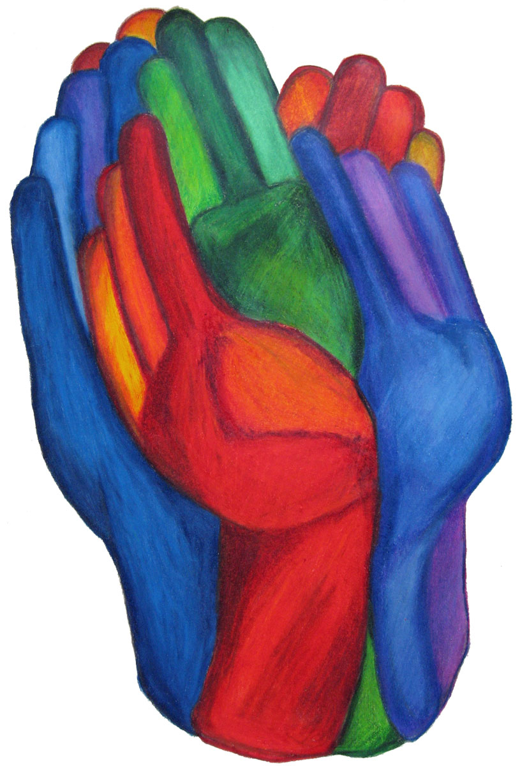
Day 1 = Ascension Day
‘… lifting up his hands, he blessed them. While he was
blessing them, he withdrew from them and was carried
up into heaven.’
Luke 24:50-51 (NRSV)
Take the time today to pray for your 5 people – that they may encounter God’s love and experience His Blessing
How can your hands bring God’s blessing to others today
This Photo by Unknown Author is licensed under CC BY

Slide 7
Day 2 = Loves
‘For God so loved the world
that He gave His only begotten Son
that whosoever believeth in Him
should not perish but have everlasting life.’
John 3:16 (KJV)
As you pray for your five and what knowing God’s love could do for them, consider how that generous love could change our community and the world around us.
What can you do to show that love today?

Slide 8
Day 3 = Speaks
‘At many moments in the past and by many means,
God spoke to our ancestors through the prophets;
but in our time, the final days, He has spoken to us
in the person of His Son.’
Hebrews 1:1-2 (NJB
As you pray for your five, pray that they will know that they are loved and accepted by God and that His one desire is to speak with them.
How can you speak God’s words to others today in a way that shows his love and care for all ?

Slide 9
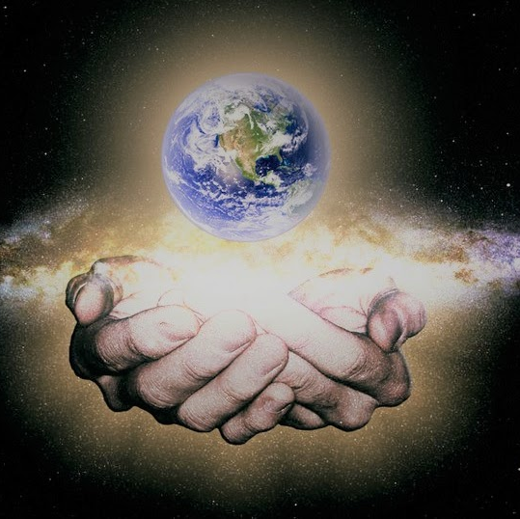
Day 4 = Creates
‘God called the dry ground "land",
and the gathered waters He called "seas".
And God saw that it was good.’
Genesis 1:10 (NIV)
As you pray for your five people today, give thanks to God for how He has created them, for their uniqueness and those qualities that make them who they are.
How can you practically show your love and care for God’s creation, both the people and the planet?
This Photo by Unknown Author is licensed under CC BY

Slide 10
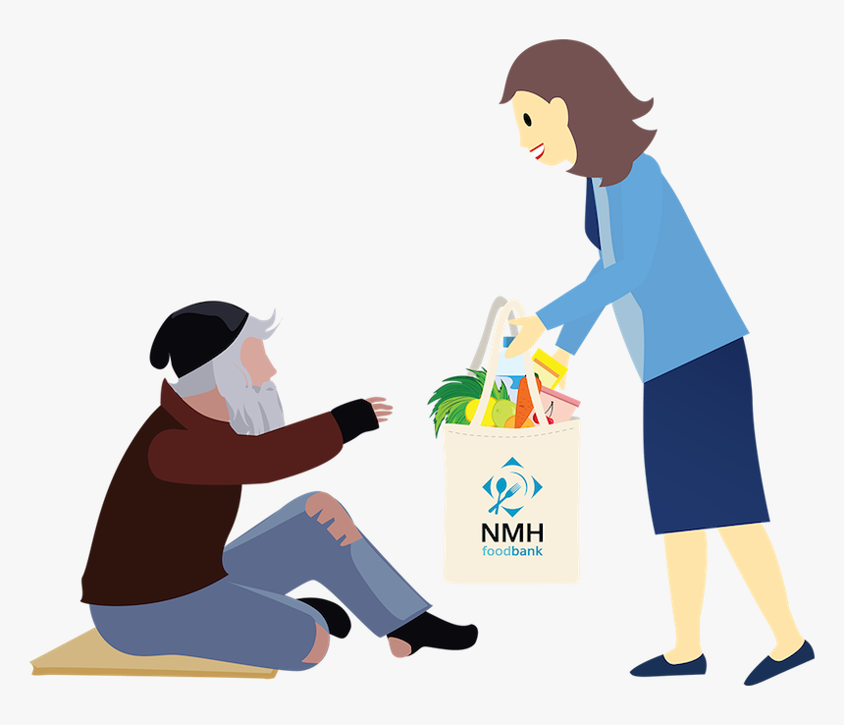
Day 5 = Gives
42 They devoted themselves to the apostles' teaching and fellowship, to the breaking of bread and the prayers. 43 Awe came upon everyone, because many wonders and signs were being done by the apostles. 44 All who believed were together and had all things in common; 45 they would sell their possessions and goods and distribute the proceeds to all, as any had need. 46 Day by day, as they spent much time together in the temple, they broke bread at home and ate their food with glad and generous hearts, 47 praising God and having the goodwill of all the people. And day by day the Lord added to their number those who were being saved.’
Acts 2:42-47 (NRSV)
Pray for your 5 people that they may know the abundance of God’s generous giving.
Show us how to give generously of all that God has given us, realising that the more we are prepared to give of the good things that He has given us the more we will receive.
This Photo by Unknown Author is licensed under CC BY-NC-ND

Slide 11
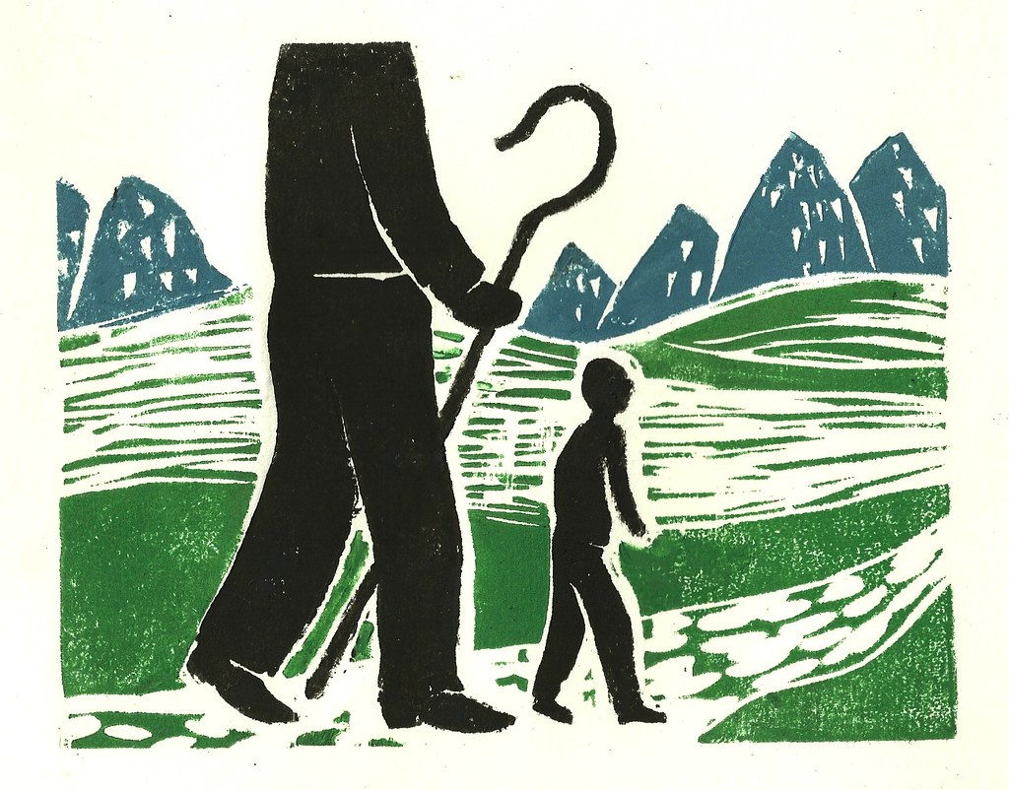
Day 6 = Walks with us
‘So do not fear, for I am with you; do not be dismayed,
for I am your God. I will strengthen you and help you;
I will uphold you with my righteous right hand.’
Isaiah 41:10 (NIV)
Pray for your five people – that God will make Himself known to them in whatever situations they may find themselves in today.
Pray especially during your day today for those living in countries where the Church is at risk of persecution. Pray that they will sense God’s loving presence strengthening them and ask him to show you ways to help them not only through pray but in practical ways also.
This Photo by Unknown Author is licensed under CC BY

Slide 12
Day 7 = Listens
‘O LORD, you have searched me and known me. You know when I sit down and when I rise up; you discern my thoughts from far away. Even before a word is on my tongue, O LORD, you know it completely.’
Psalm 139: 1, 2, 4 (NRSV)
Pray for your five people – that they will turn to God in prayer, that they will know His love and that He is always listening to them and is ever present.
Can you share with your five friends that you are praying for them and that God always hears their prayers?

Slide 13
Day 8 = Saves
‘... He saved us, not because of any works of righteousness
that we had done, but according to His mercy, through the
water of rebirth and renewal by the Holy Spirit.’
Titus 3:5 (NRSV)
Pray for your five people, that they will come to know the saving love of God.
Read Psalm 40 (or another of your choice) and join in praise to the God who saves. ‘Mighty to save’ is a great song. You can find it at: https://youtu.be/-HLVnPjbSaI
We listen to it now as we pray for our 5

Slide 14
Day 9 = Encourages
‘So do not fear, for I am with you; do not be dismayed,
for I am your God.
I will strengthen you and help you; I will uphold you
with my righteous right hand.’
Isaiah 41:10 (NIV)
Pray for your five people that they will know the peace and presence of Christ in their lives, encouraging through the difficulties of life.
As we go about our daily business where can we find opportunities to follow St Barnabas’ example- to be “Sons and daughters of encouragement” - in our engagement with others?

Slide 15
Day 10 = empowers
Then Mary said, ‘Here am I, the servant of the Lord;
let it be with me according to your word.’
Luke 1: 38 (NRSV)
Pray for your five people, that they will experience God’s life transforming love and be empowered to be all God has created them to be.
Each day, pay attention to the people who provide services for us (however routine or ordinary), and thank them by name, where possible.

Slide 16
Day 11 = Pentecost
‘. . . how much more will your Father in heaven give the
Holy Spirit to those that ask him!’
Luke 11:13 (NIV)
Pray 'Come Holy Spirit' over yourself and the five people you are praying for

Slide 17
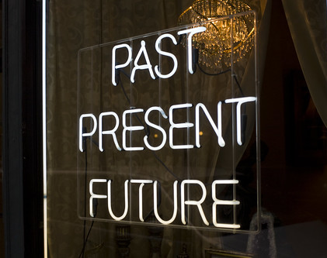
I Believe
It has come
It will come
It is here.
This Photo by Unknown Author is licensed under CC BY-SA-NC

Slide 19
We are not made for the harbour We are made for the sea Though at times it's wild and cold and dark It's where we're meant to be
You launch us out as a Father Though we may be tossed about But your presence in the storm It walls us in and calls us out
You left the safe port of heaven For the elements of earth This God at risk, exposed
Your gaze is holding the horizon
Where that heaven brushes earth So this worn world is transformed
You send us out to the market Send us out to the field
Jesus' hope ambassadors
We take no purse for the journey But take your authority To declare that all is yours
Out to the office, leaving his mark Out to the factory, his spirit the spark Out to the school gates, and out to the bars May we risk what was never ours
We are not made for the harbour We are made for the sea Though at times it's wild and cold and dark It's where we're meant to be
You launch us out as a Father Though we may be tossed about But your presence in the storm It walls us in and calls us out

Slide 20
As we leave here today how will you endeavour to enable
“Thy Kingdom Come” to have meaning for the five people you are praying for?
Will you endeavour to pray for them as often as you can?
Will you try and put into practice as many of the action points that we have prayed about today as you go forward, not only during this period but always?

Slide 21
Come down O love Divine
Seek thou this soul of mine
And visit it with Thine ardour glowing
O Comforter draw near
Within my heart appear
And kindle in it
Thy holy flame
Bestowing
Amen

